Slide 1
P&T challenges during deinventory of legacy facilities
CTMA 2017
drhgfdjhngngfmhgmghmghjmghfmf
Dan Pancake
Jeff McGhee
Project Manager
Nuclear Facilities Deactivation
dpancake@anl.gov
Transportation Nuclear Facility Manager
ESH and P&T Lead for Deinventory
jmcghee@anl.gov
Contractor’s Transportation Management Association Meeting
May 2017, Point Clear, AL

Slide 2
DEACTIVATION AND DEINVENTORY
Facilities Deactivation Activities That Generated Packaging and Transportation Challenges
Alpha Gamma Hot Cell Facility
~66X HC2 SOF
Irradiated Fuel Samples and Test Specimens (Fuel Examination Waste)
Sodium Bonded Fuel Debris & Pin Fragments
Building 205 K-Wing Hot Cell Complex
Separations Science Byproducts
ATM Standards (Additional FEW)
Building 200 MA Wing Hot Cell Complex
Irradiated Neutron Sources
Higher Energy Gamma Source Materials
“XYZ” Box and Other “Home Made” Source Materials
Legacy Materials in the Waste Management Facilities
CP5 Shield Plug Assemblies
Building 350 (Formerly New Brunswick Laboratory)
Transuranic Metals and Oxides in type B Quantities / Unique Containment
National TRU Program Support for RH TRU Disposition
Shielded Container Assemblies

Slide 3
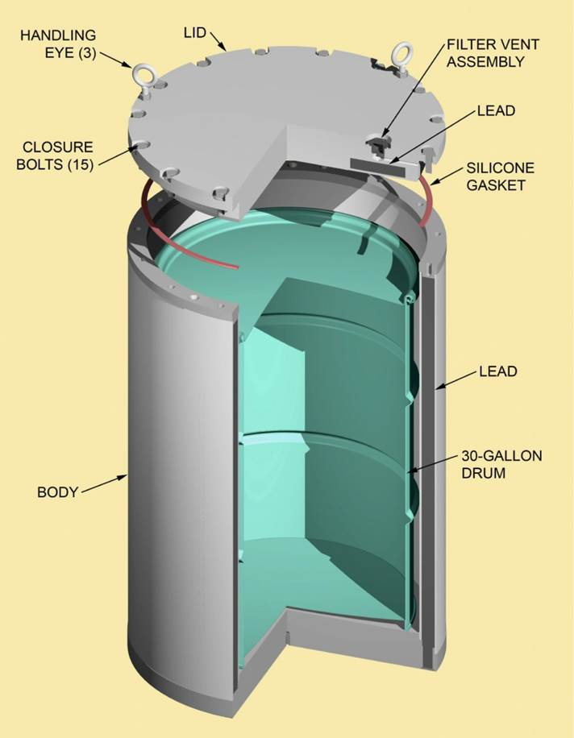
DEACTIVATION AND DEINVENTORY
Work with National TRU Program on Pilot Project
Shielded Container Assembly (SCA-1)
Used as an approved overpack for disposition of certain RH TRU debris containers as CH TRU Packages at WIPP
Provides shielding via one-inch lead layer between the containment surfaces.
Shipped in the HALF-PACT to WIPP
Disposed above grade, as other CH TRU Packages
Licensed content in the TRUPACTs
ANL partnered with NWP to execute the pilot program for loading and shipping in 2013 (9 SCA-1s)

Slide 4
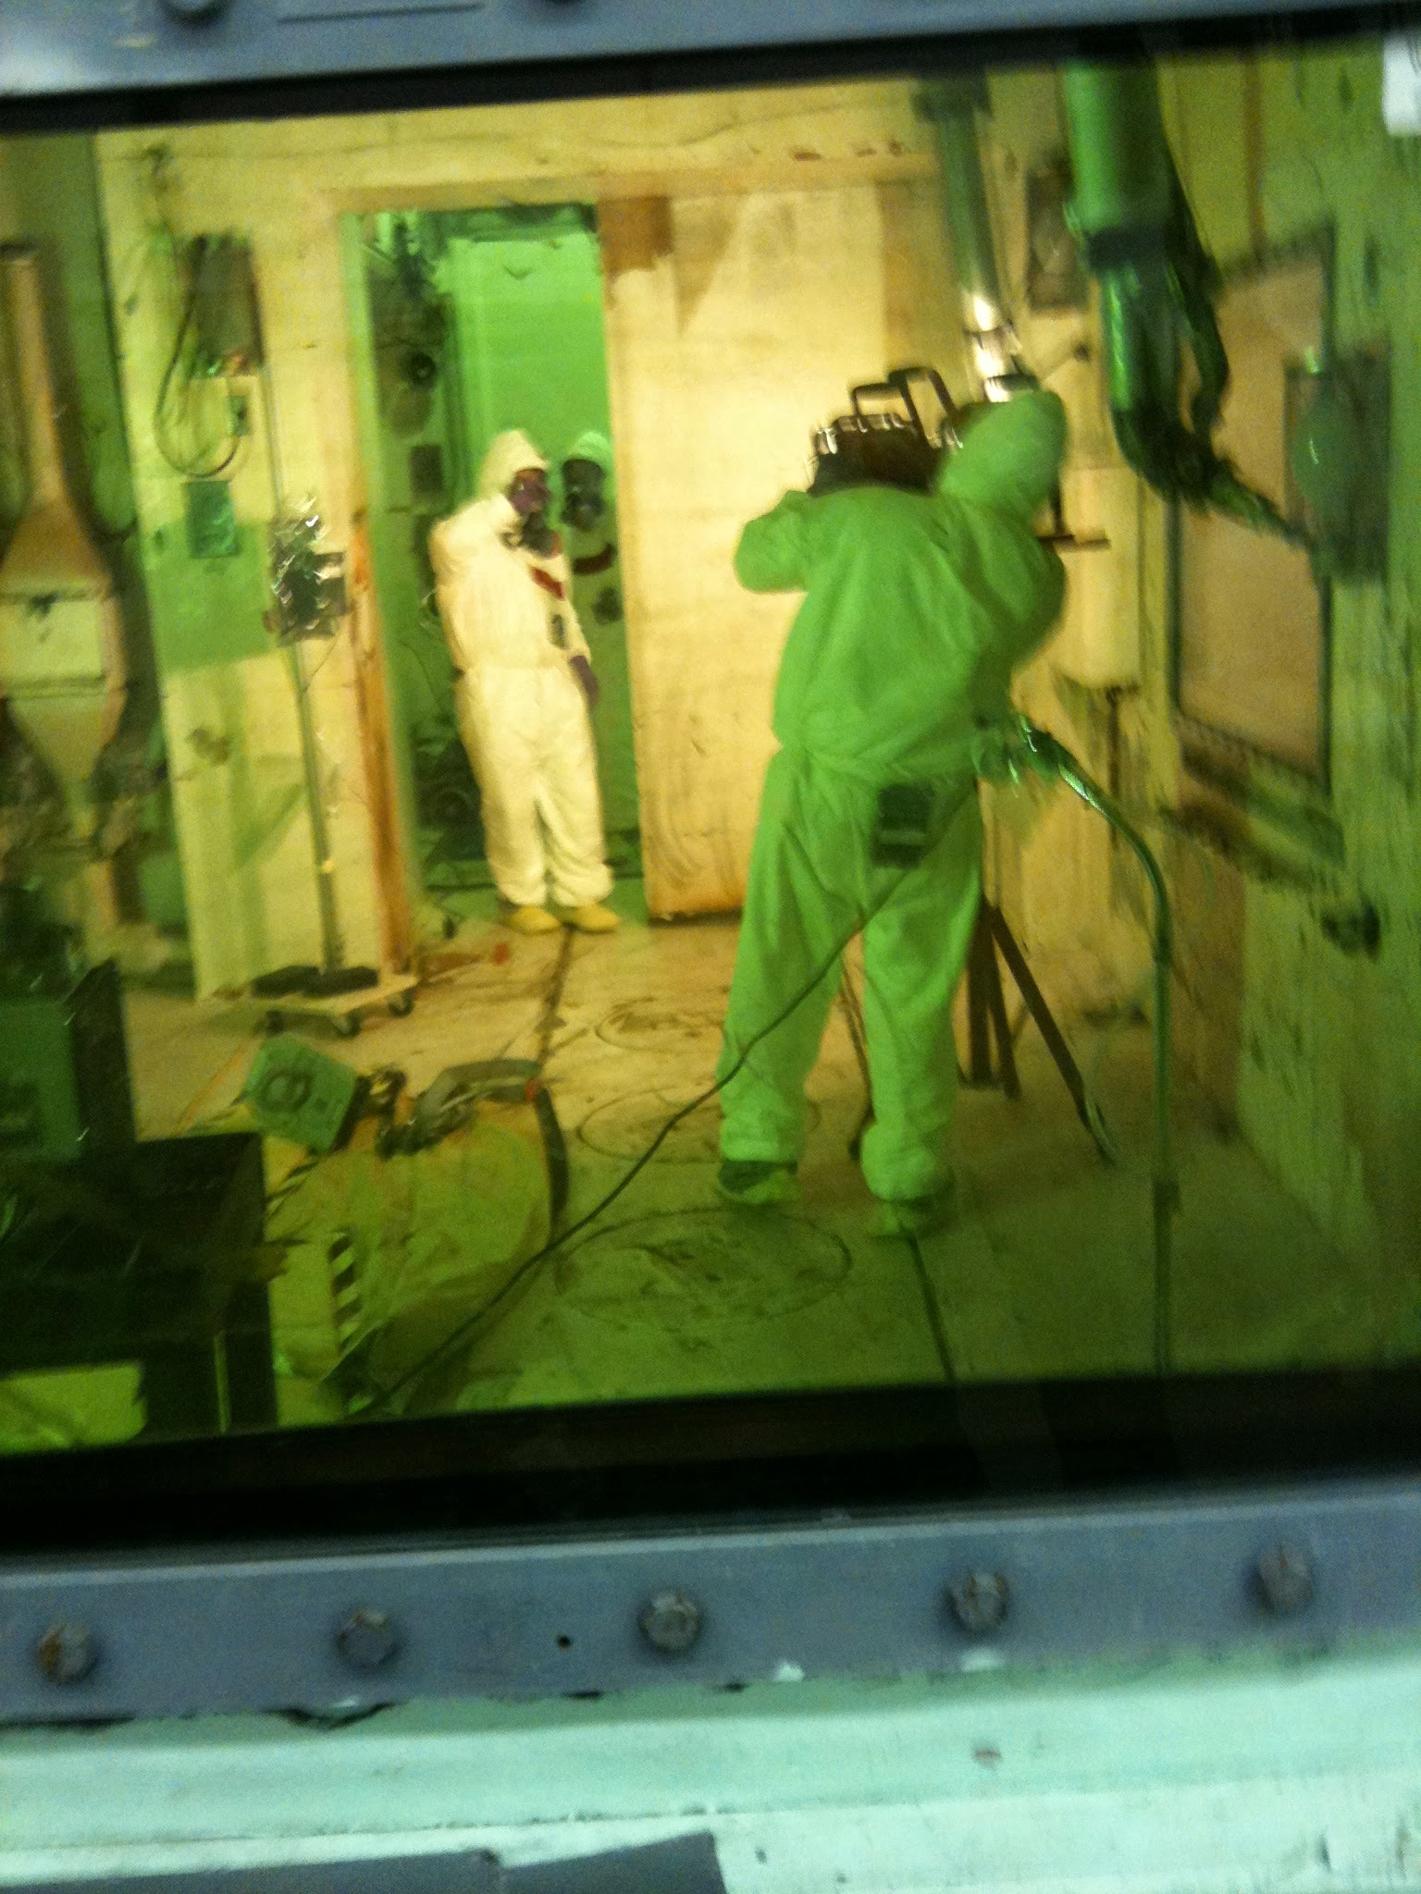
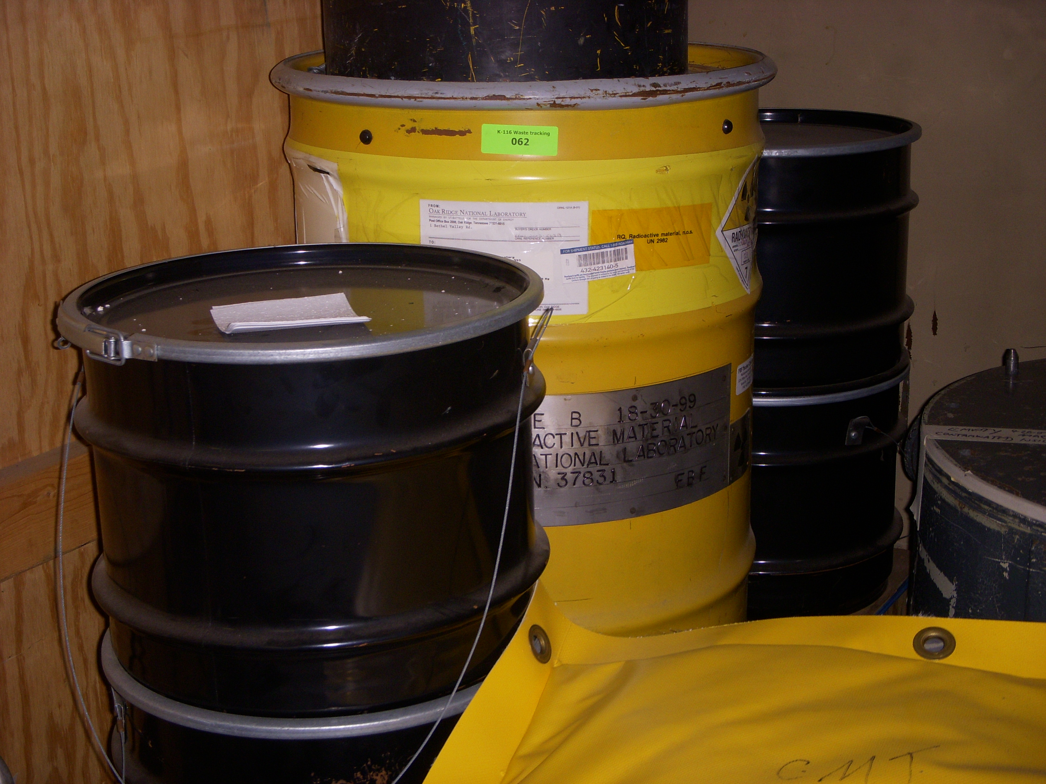
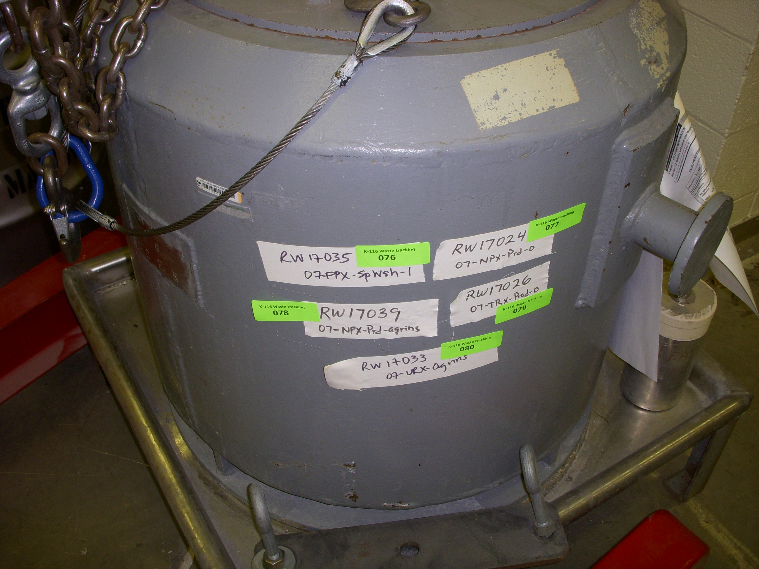
Challenge 1
Can you get to the material?
“Cheap to Keep” facilities don’t often function as designed
Doors don’t open
Lights don’t turn on
Hoists don’t work or have not been serviced
Floor storage corroded or has water seepage
Packaging used is *vintage* now, and likely not compliant
6M’s
Gaskets that dry rot

Slide 5
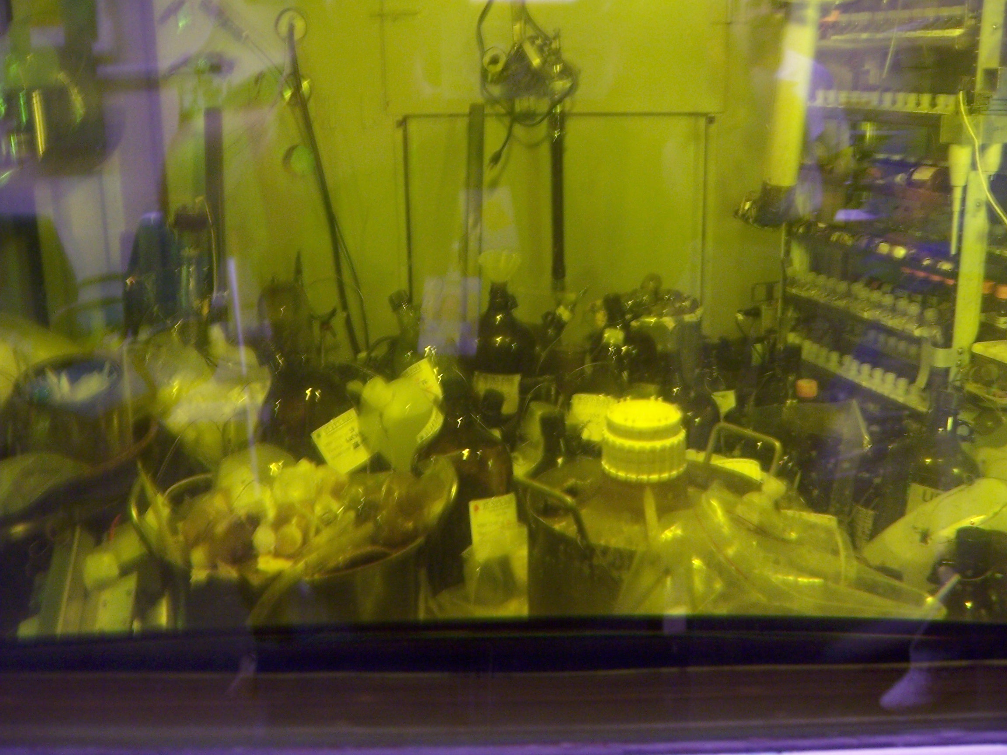
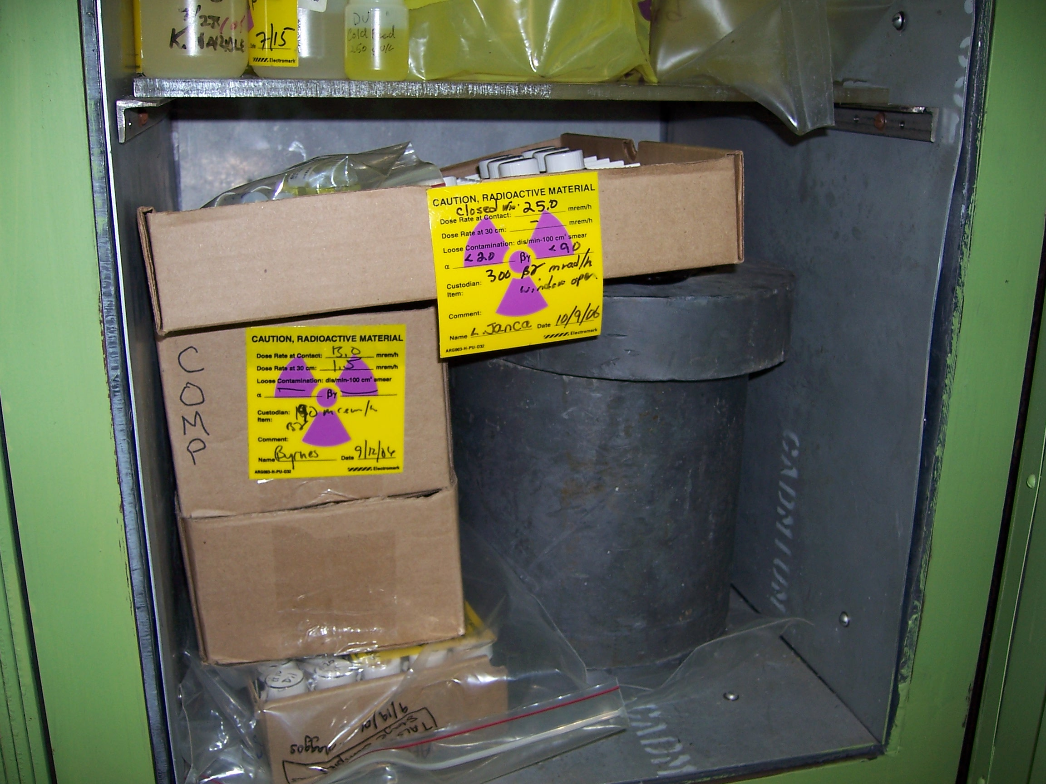
Challenge 2
What is that?
Understanding what you really have
Often requires extensive NDA/NDE and legacy data gathering, where data are available at all
Legacy facilities sometimes have no living souls left to consult with
Handwritten notebooks…well
If you can read them
Stylistic differences in data recording methodology can be a challenge
Incomplete information (think batch division and consumed)
SURPRISE!
Is that what we think it is?
Does someone really want that?

Slide 6
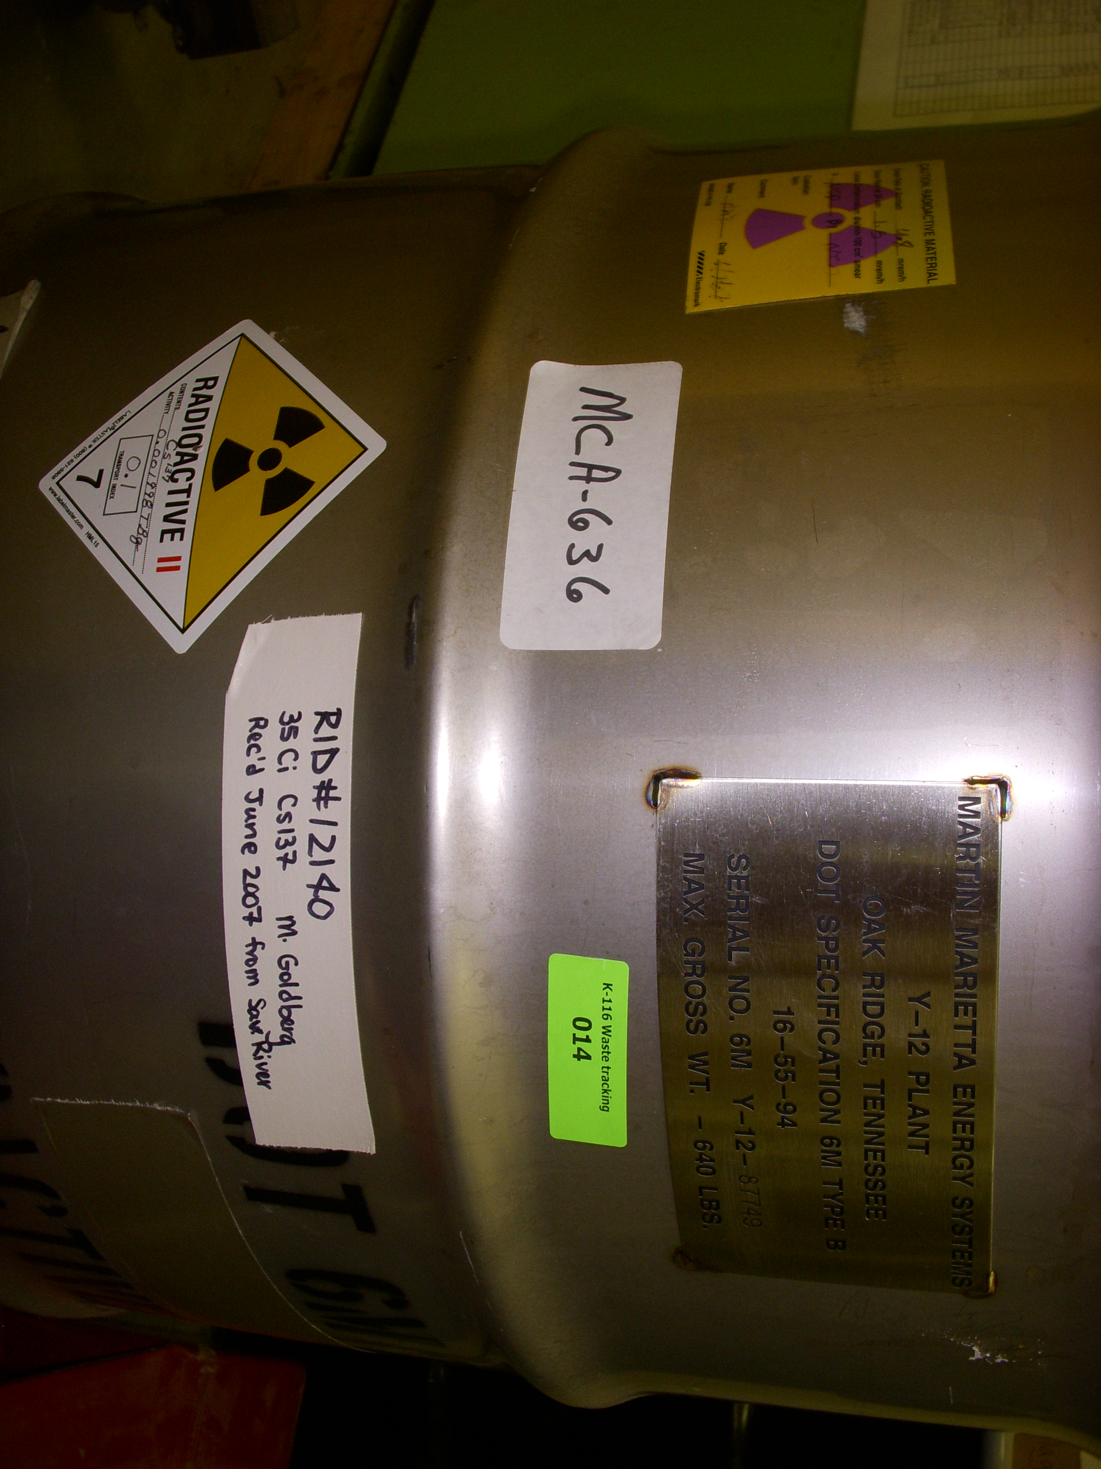
Challenge 3
We used to ship that in a 6M all the time…
No authorized packaging for that material/activity
Creativity in description to better match material
Mixed fission products
Fuel Examination Waste
Regulatory approval process for content modification is
Costly
Lengthy
Requires good coordination
PCP assistance is ESSENTIAL for success

Slide 7
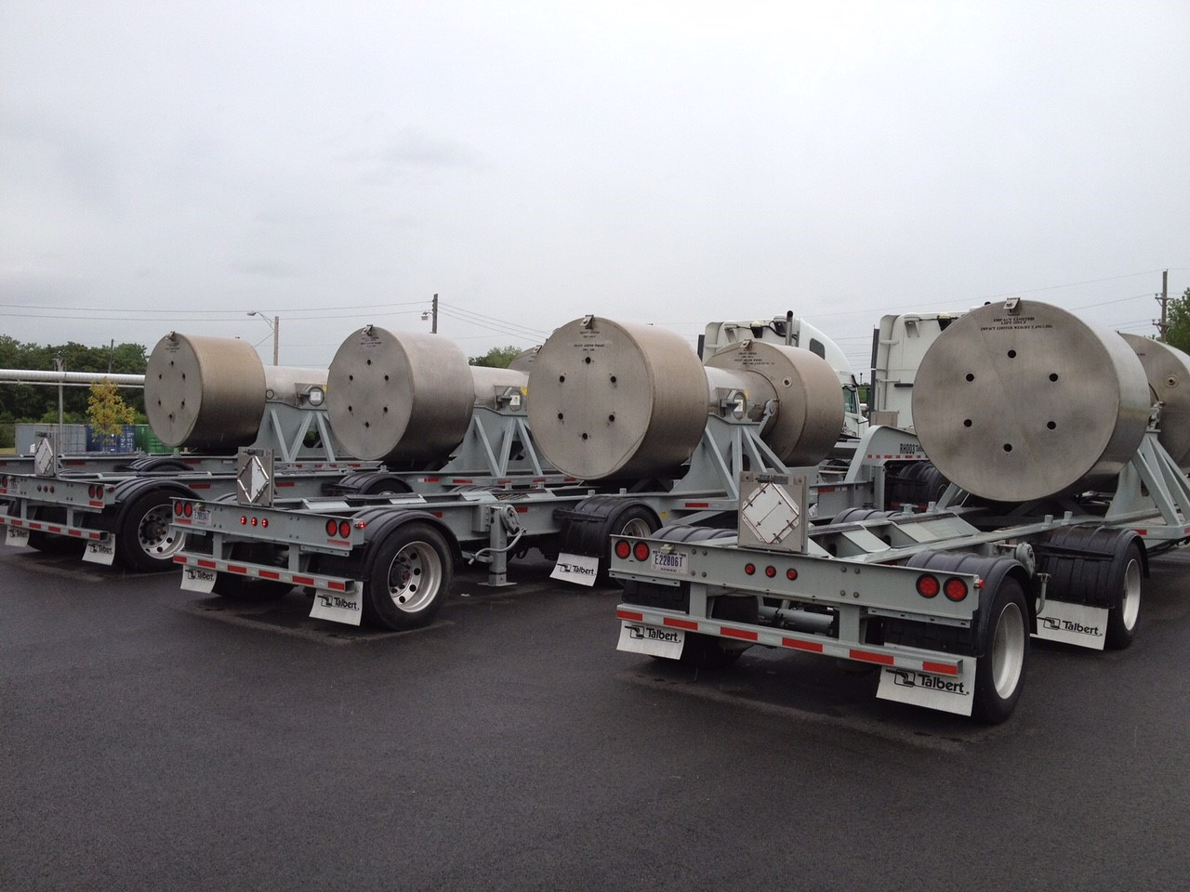
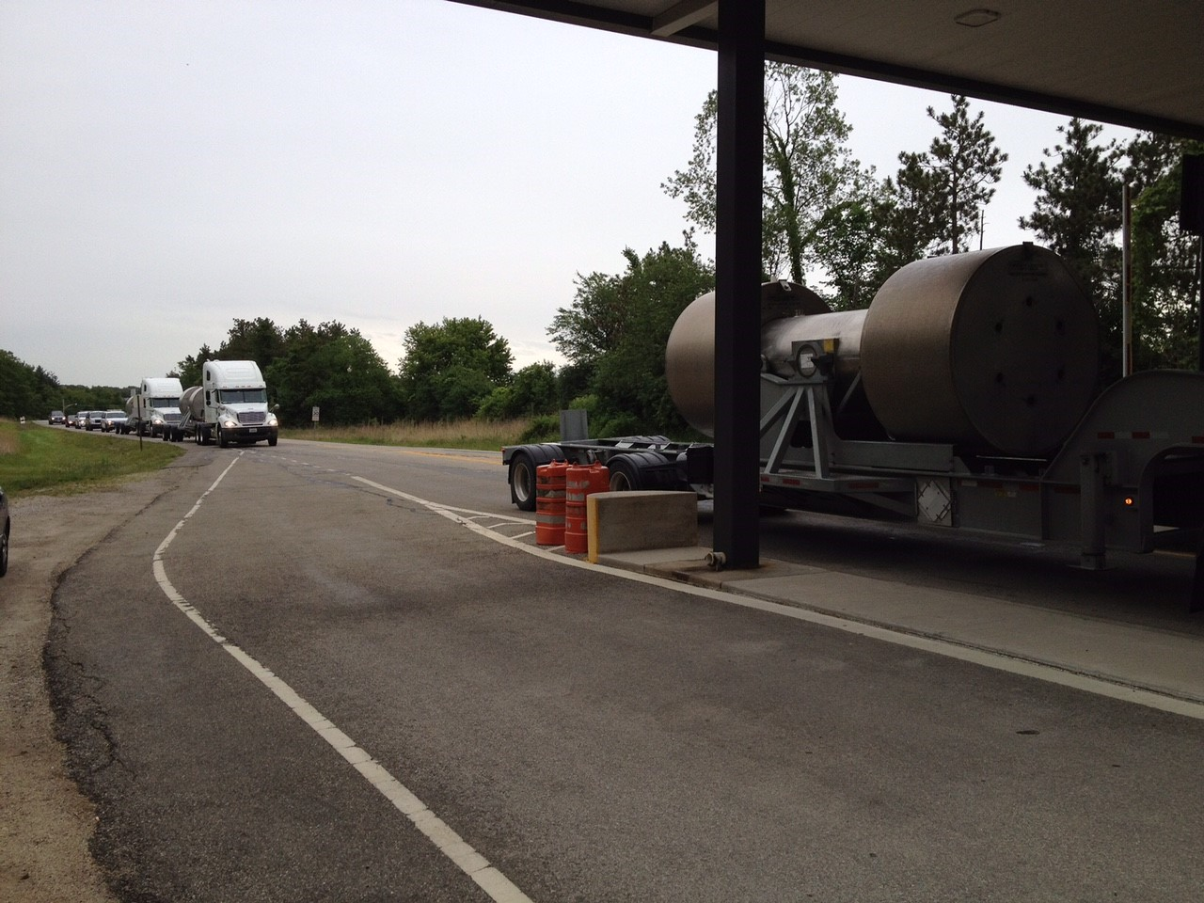
Challenge 4
Coordination with EM, NNSA, Security, States, Disposition Sites
What requirements apply to your “stuff”?
Who needs to be involved, and when, will certainly vary with material
What was done in 1992 is NOT the same as today
Coordination with package owner essential, as resources and expectations may be different when working with DOE versus NRC
Have “road ready” packages to take advantage of available Bandwith

Slide 8
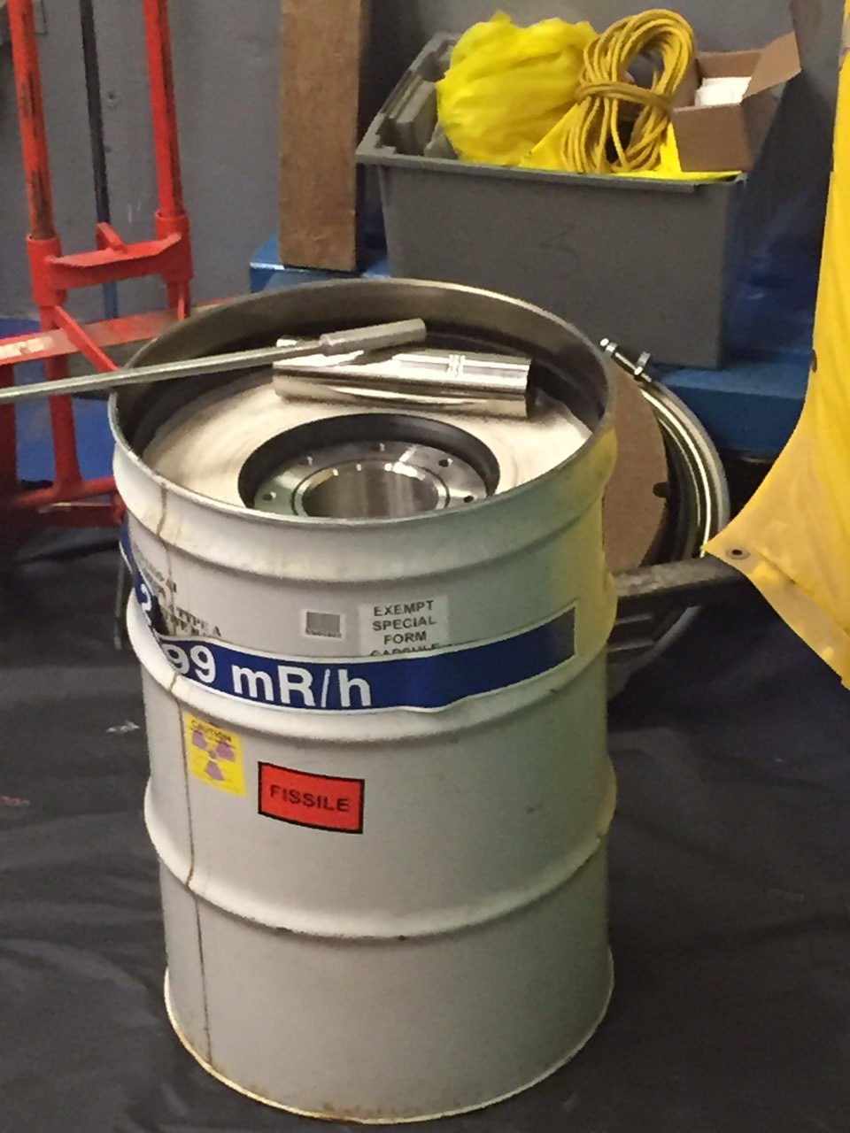
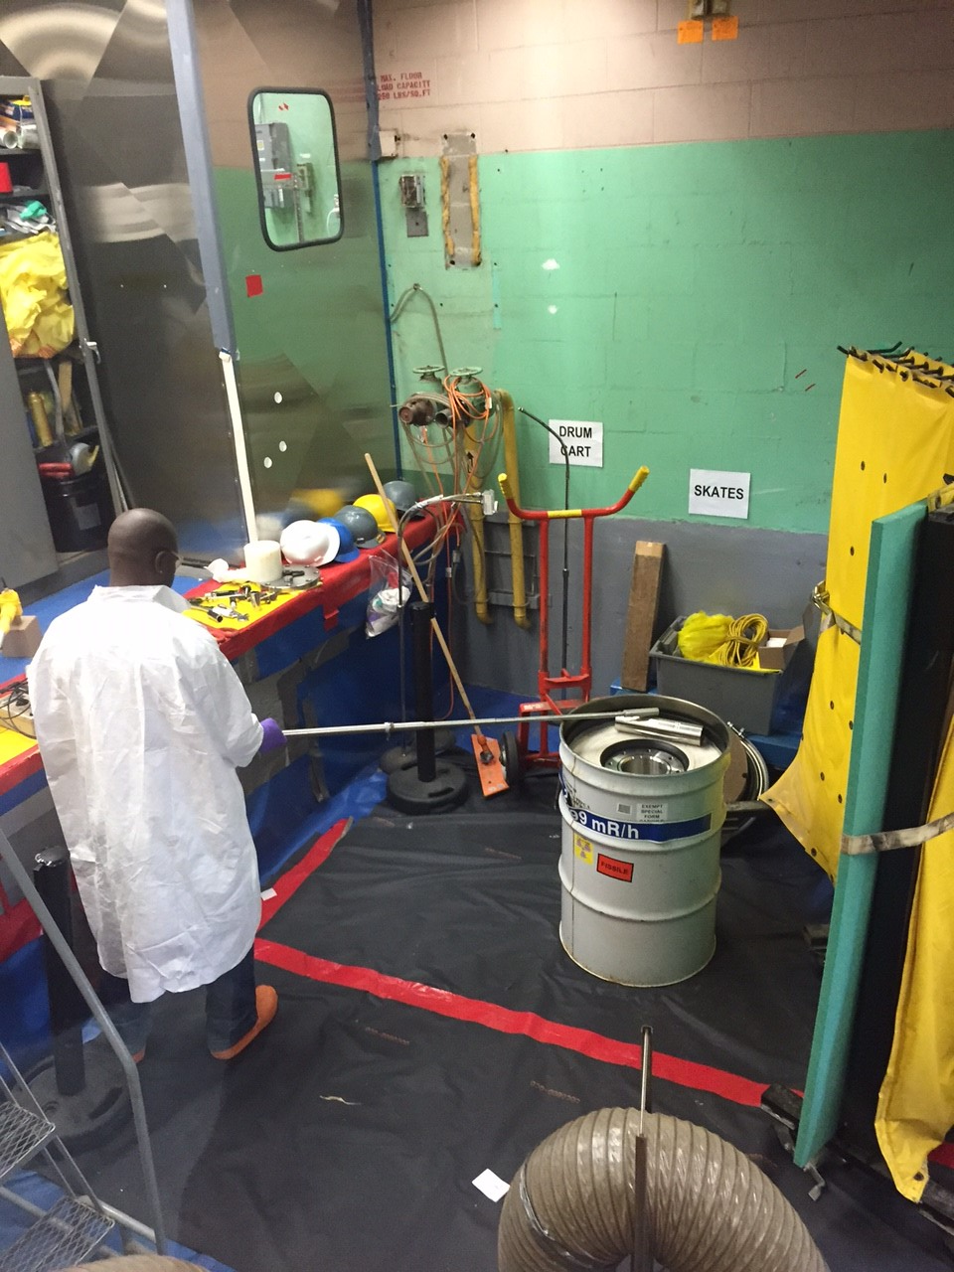
Challenge 5
Source Materials Are Unique, OSRP CAN Help!
Older, unique or high activity materials that have source capability may be OSRP candidates
Coordination with OSRP for contents authorization for special form capsules important
QA procedures for “filling and fabrication” of OSRP capsules can be coordinated
Additional time needed
Dedicate a staffer or two to be trained to allow continued operation
Intermediate storage and ultimate shipping difficult for Type A, high dose neutron sources
RaBe, AmBe, PuBe and Cf need S100 packaging, or custom fabricated and tested

Slide 9
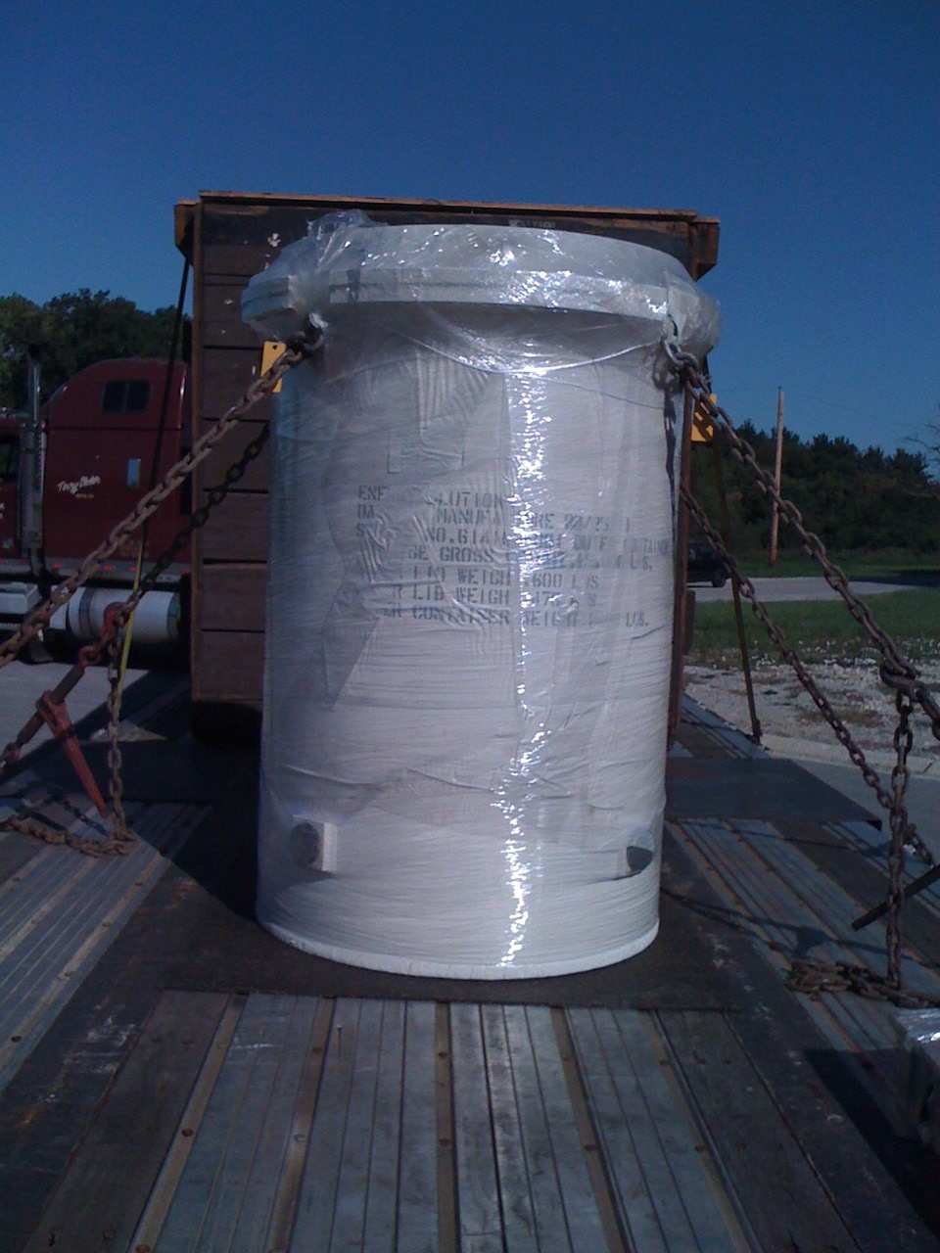
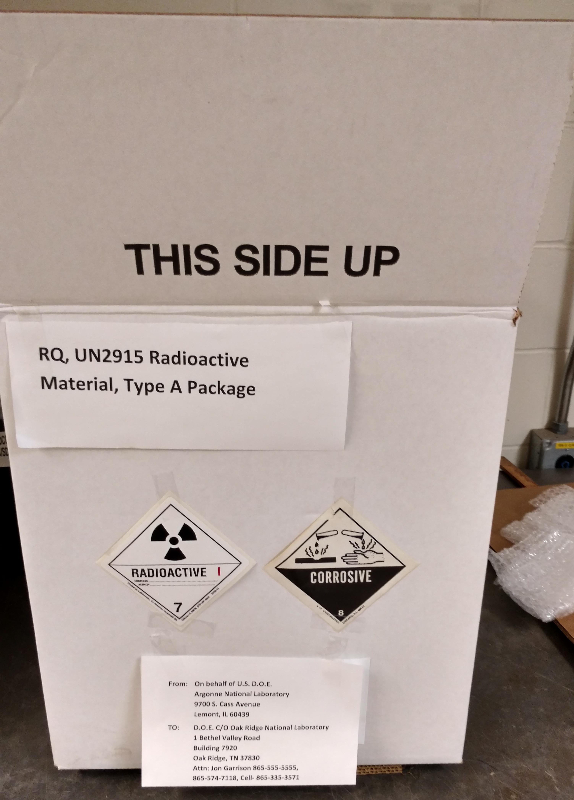
Challenge 6
Wow, that is a LOT, or not something we see…we don’t have anything for that
Don’t shy away from engineering evaluation and solutions. Packages can be fabricated for a given package to deal with high dose issues
RaBe and Co content needed special inner container for dose
Design your own solutions for use with packages
Partner with manufacturers/fabricators
Use COTS and retest for Type A, then split your stuff to “fit”

Slide 10
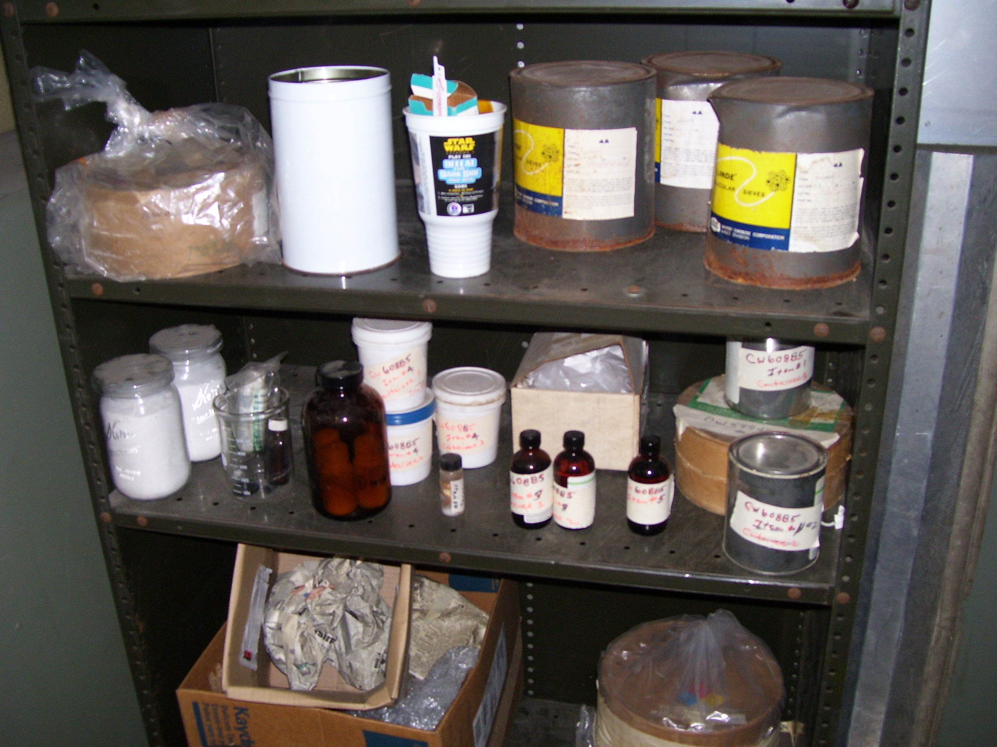
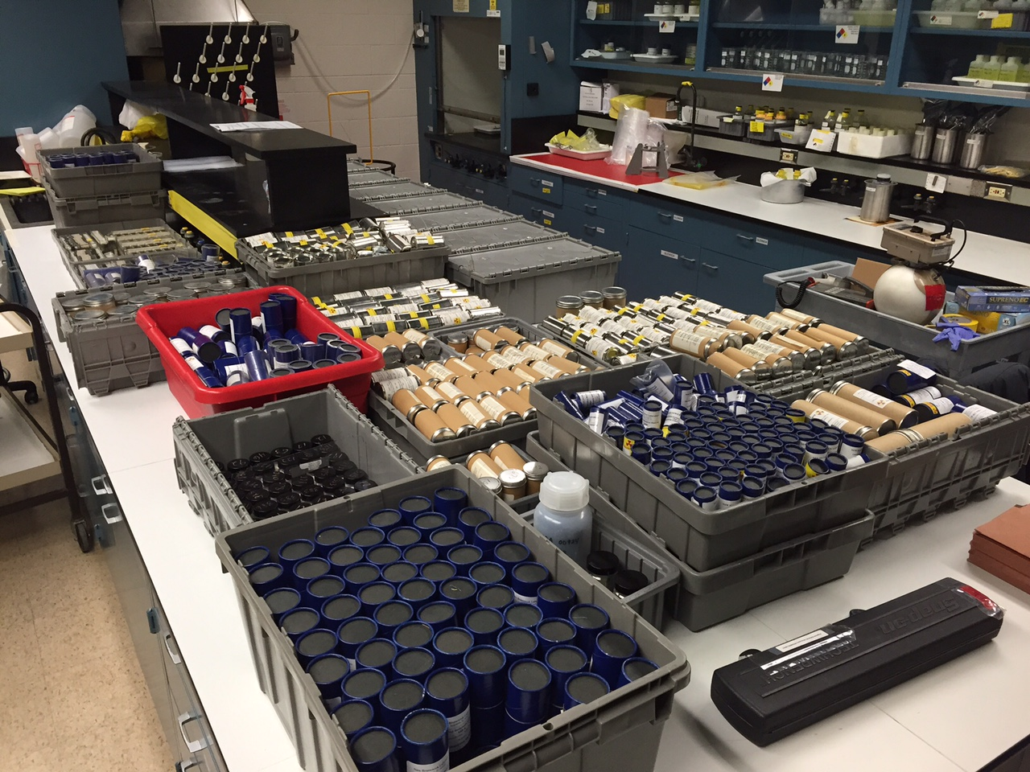
Challenge 7
Yep that material is authorized, but the primary containment, like glass bottles, is not…
Most legacy facilities have limited operations that are authorized.
If the target material(s) is/are not in exactly the configuration for authorized content…
Content modification may be needed
Engineered solution may be needed
Get PCP and package owner involved EARLY
DOE/NNSA “ownership” coordination needs to happen at your site office/program office level

Slide 11
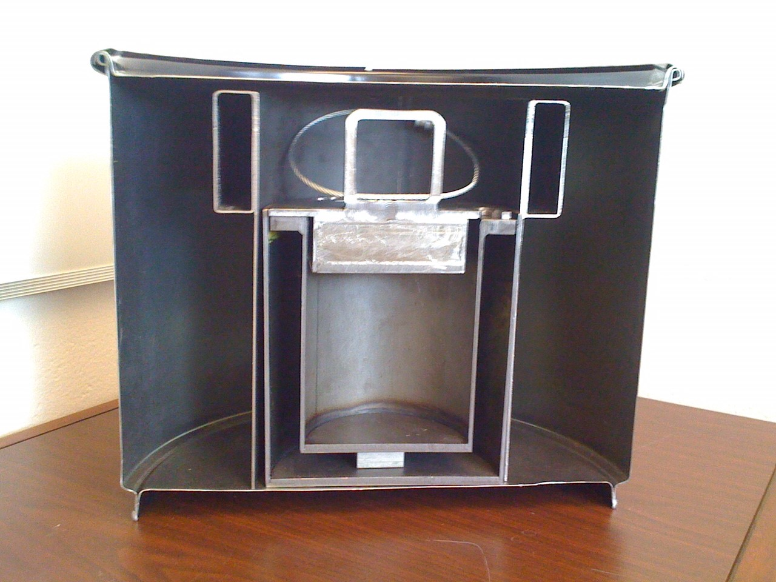
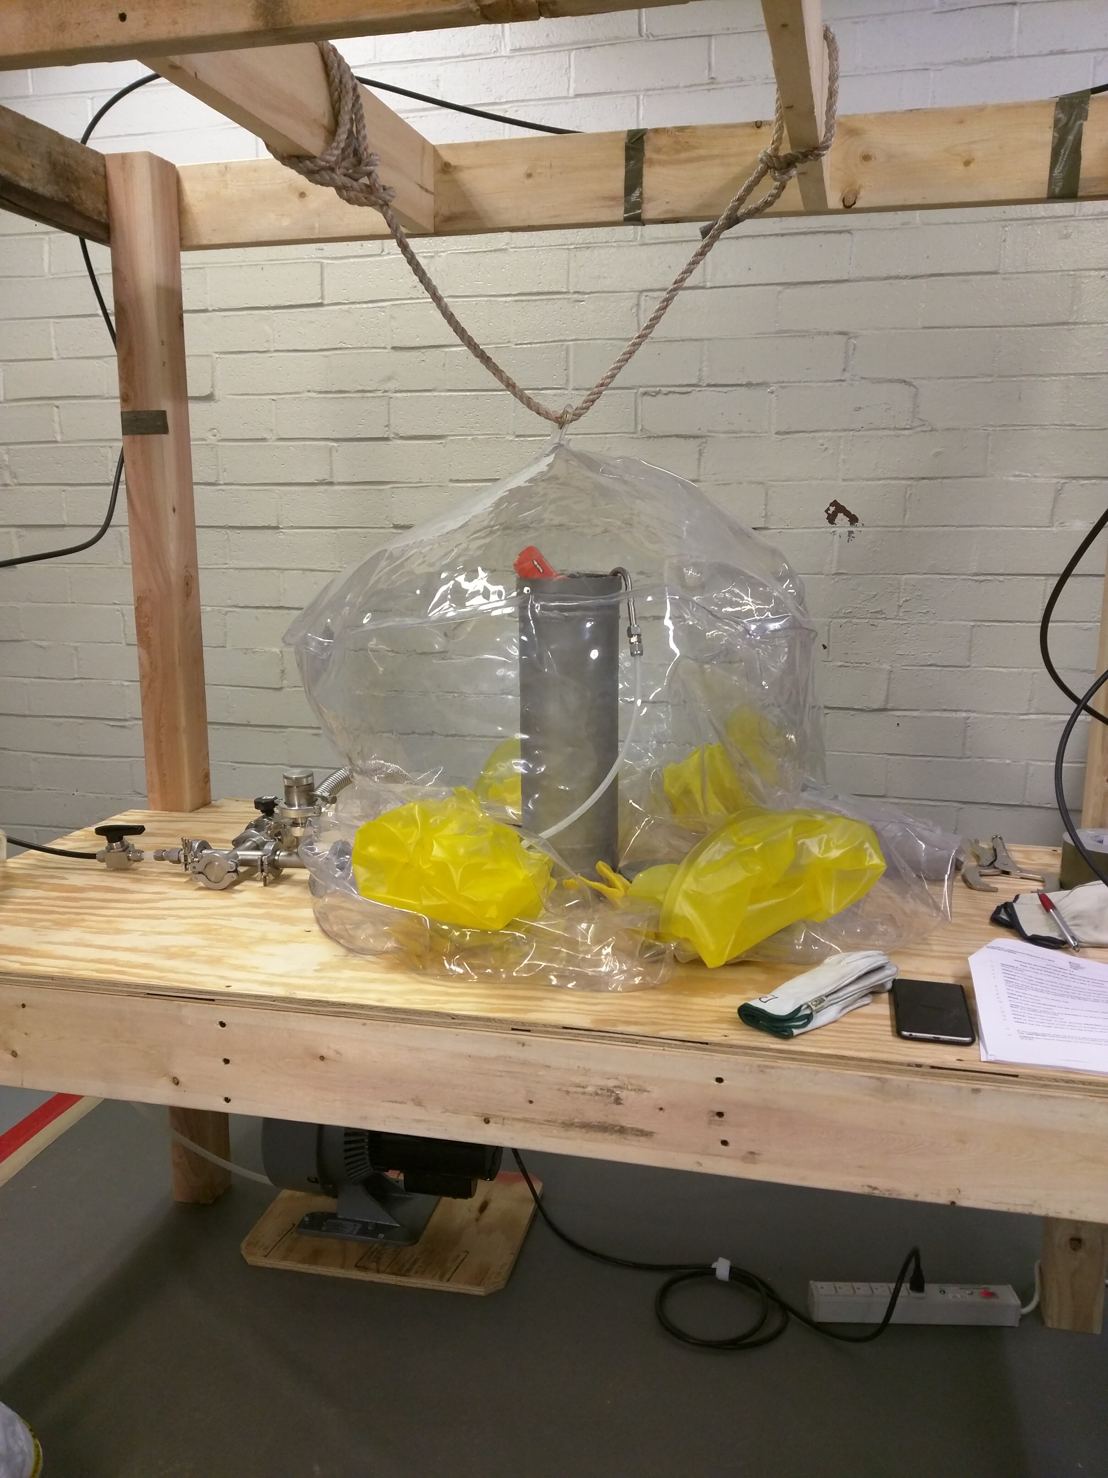
Challenge 8
Convincing your DOE partners and your management to let you be a pioneer of new processes/ideas
If there is a concept or idea that may be of benefit to others with similar materials or issues in the DOE Complex, push forward…
Resistance to change can be hard
Intellectual property and process can be a challenge and take up time
Costs initially…vary a great deal, long term savings must be balance funding, safety, and return on investment

Slide 12
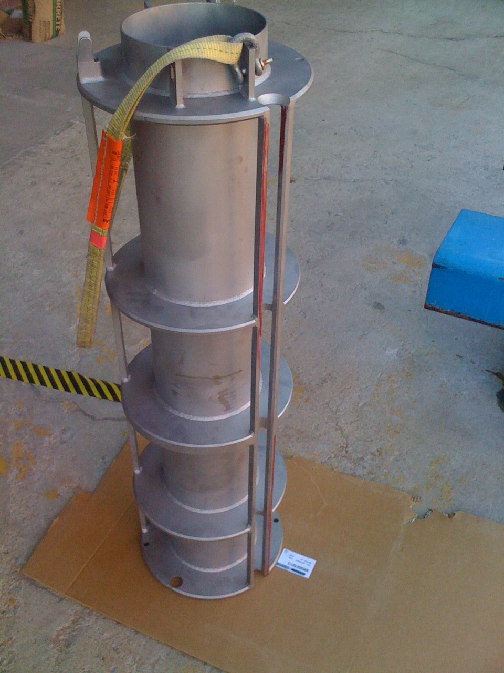
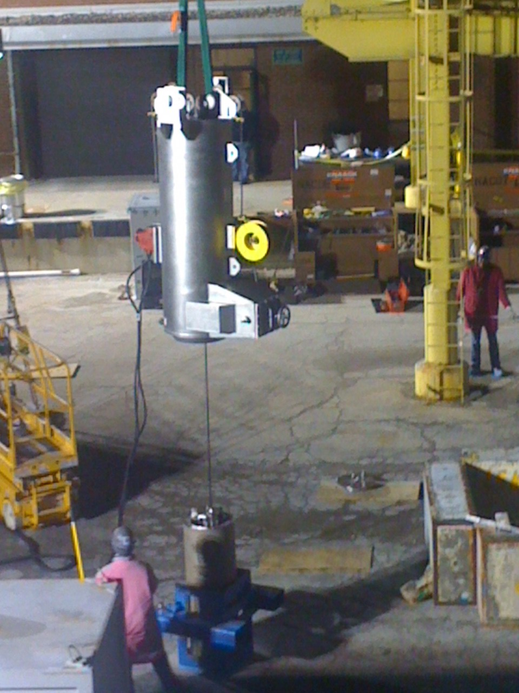
Challenge 9
There will be an issue…be ready…stay calm…
Know your design solutions
Sodium bonded fuel needed special solutions for FEW into tubes, into racks that will fit with transport cask chosen
Be sure you have a listing of Q and non-Q parts and features PRIOR to acceptance, even if contracting others to do the work
When problems arise PCP is your pathway to solutions!

Slide 13
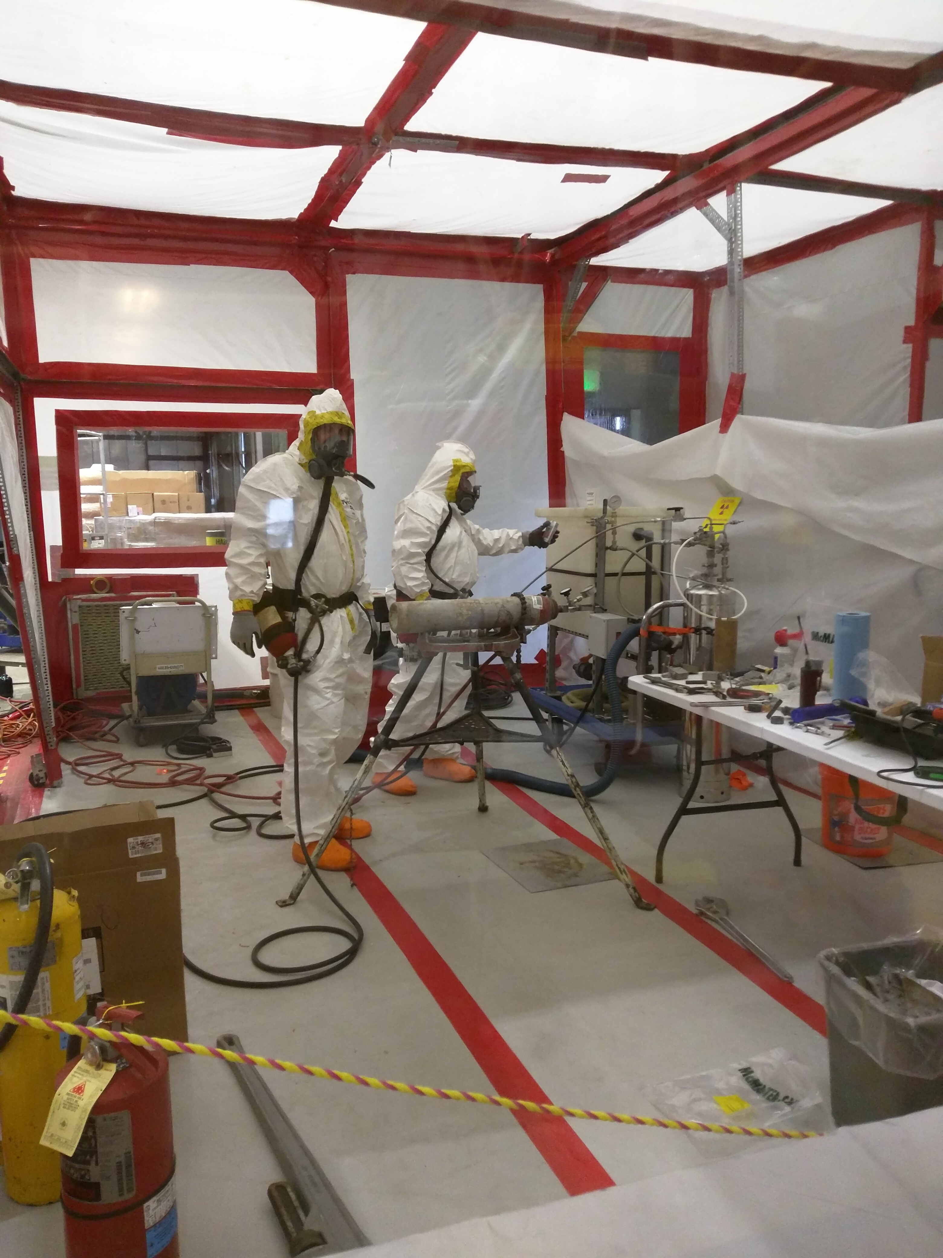
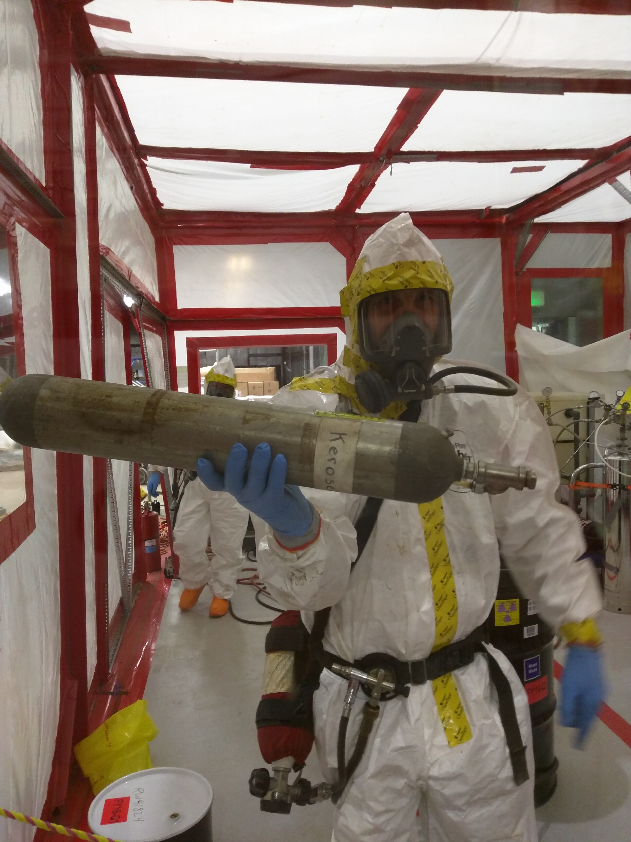
Challenge 10
There is no packaging solution. We don’t know what it is. Now what?
Work with a vendor and/or other DOE sites to find a solution
Deal with the off-spec and “no reuse path” materials as waste
Work with your MC&A Team, as well as DOE Site Office, to ensure material can be wasted
Develop new and novel methods to handle unusual materials

Slide 14
Questions?

