Slide 1
SRNL-L4500-2017-00028 Rev. 1
DOE Packaging Certification Program Certification, Technical Support and Training
Jeff England
SRNL Packaging Technology Program Manager
Contractors Transportation Management Association (CTMA) 2017 Workshop
May 23 – May 26, 2017

Slide 2
Overview
Certification Process
DOE Radioactive Material Shipments and Consolidation
DOE Packaging Certification Program
What can the DOE-PCP do for you?
Keep going for information on SRNL family colors.

Slide 3
PCP Certification Process
DOE Certification Authority in 10 CFR 71
PCP Certification Process
http://rampac.energy.gov/Flowchart
Assistance is available
http://rampac.energy.gov/AssistTeams
Keep going for information on SRNL family colors.

Slide 4
PCP Training
DOE Order 460.1D
PCP Training
http://rampac.energy.gov/training
Keep going for information on SRNL family colors.

Slide 5
Graduate Certificate in Nuclear Packaging is a Partnership Between
Keep going for information on SRNL family colors.

Slide 6
Purpose of Certificate
Provides a curriculum in packaging for nuclear and other radioactive materials that
Complements graduate programs in Mechanical, Nuclear, and Materials Engineering, and
Is more applied-knowledge-based than research-based.
Encourages students to complete a curriculum in packaging safety and security that has both depth and breadth.
Provides a graduate-level curriculum that is
Designed to give students an advantage when seeking employment or advancement in the area of nuclear and other radioactive materials packaging, or related fields, and is
Regionally accredited (by the Northwest Commission on Colleges and Universities)
Keep going for information on SRNL family colors.

Slide 7
9-credit Certificate Requirements
Required Courses (4 credits)
ME 691 - ASME Pressure Vessel Code for Nuclear Transport and Storage, 1 credit (ANL)
ME 692 - QA for Radioactive Material Packaging, 1 credit (ANL)
ME 695 - SARP Review and Confirmatory Analysis, 2 credits (LLNL)
Elective Courses (choose 5 or more credits)
ME 694 - Nuclear and Other Radioactive Materials Transport Security, 2 credits (ANL)
ME 696 - Management of Safety Analysis Report for Packaging (SARP) Preparation, 1 credit (SRNL)
ME 697 - Radioactive Material Package Operations and Leak Testing, 1 credit (SRNL)
Three more 1-credit courses are being develop at Oak Ridge and Sandia National Labs (~2017)
At UNR (Mechanical Engineering, and Materials Science and Engineering classes)
ME 675 - Introduction to Combustion, 3 credits
MSE 601 - Corrosion of Metals, 3 credits
MSE 665 - Nuclear Power Fundamentals, 3 credits
MSE 666 - Nuclear Fuel Cycle, 3 credits
MSE 667 - Radiation Detection and Measurement, 3 credits
MSE 668 - Nuclear Materials, 3 credits
Keep going for information on SRNL family colors.

Slide 8
Admission Requirements
An earned baccalaureate degree in mechanical, materials, nuclear or a closely-related engineering field, or
A baccalaureate degree and background in project management related to packaging of nuclear and other radioactive materials.
Keep going for information on SRNL family colors.

Slide 9
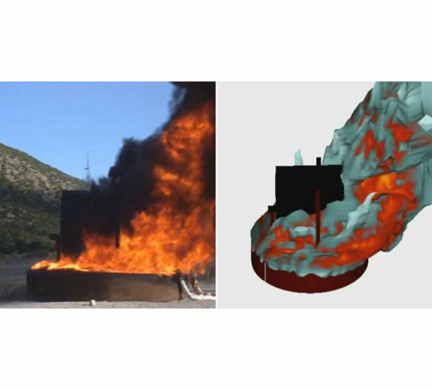
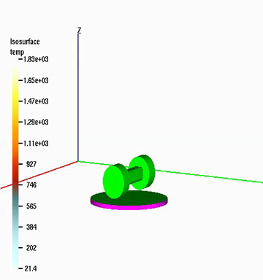
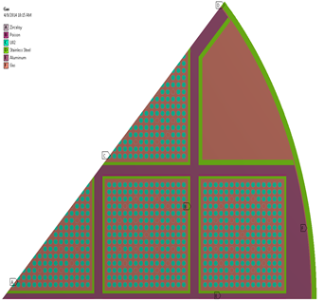
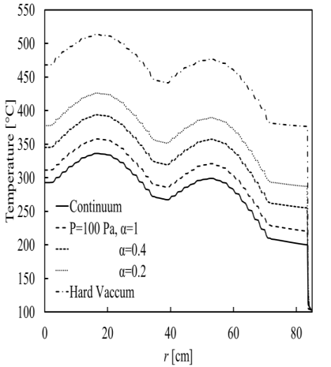
Nuclear Packaging Research at UNR
UNR was chosen to host the Graduate Certificate in Nuclear Packaging because it has conducted Nuclear Packaging Safety Research since 1993, with funding from US DOE, NRC, State of Nevada
This has involved development and experimental benchmark of Computational Fluid Dynamics Simulations to predict
Heat transfer from large fires to engulfed or nearby transport packages
Temperatures of used fuel within transport packages for normal or hypothetical fire accident conditions.
Temperatures of used fuel within transfer casks under vacuum drying conditions
Performance of decomposing polyurethane foam in nuclear packaging during exposure to accidental fires

Slide 10
Current Reality for PCP
Severely curtailed funding has PCP services operating at a minimum. As the year progresses, some services will probably be shut down.
Training courses,
RAMPAC updates or closure,
Assistance may be curtailed, and
Dockets will take longer to process.
Keep going for information on SRNL family colors.

