Slide 1
Life at SRS After RADCALC
The joys of making radioactive determinations
Kevin Coley, DSL
Lead, Hazardous Materials Transportation
CTMA 2017
May 24, 2017

Slide 2
Life at SRS after RADCALC
Radcalc is a software application that provides consistency, accuracy, reproducibility, timeliness, quality, compliance, and appropriate documentation to shippers of radioactive materials and wastes at U.S. Department of Energy (DOE) facilities nationwide.
RADCALC Software Advisiory dtd March 26, 2015, Review of Federal Oversight of Software Quality Assurance for RADCALC
On March 16, 2015 the Defense Nuclear Facilities Safety Board (DNFSB) issued a letter identifying deficiencies in the proper oversight, maintenance, and use of RADCALC. RADCALC is a DOE acquired computer program used to perform regulatory transportation calculations based on isotopic content. DNSFB stated that “these deficiencies could result in vulnerabilities in RADCALC's calculation of decay heat, radioactivity, and/or hydrogen gas generation, which could result in serious consequences for workers and the public in the event of a transportation accident.”

Slide 3
Life at SRS after RADCALC
July 7, 2015, DOE-HQ EM-33 issued letter suspending use of RADCALC 4.1, effective 7/13/15 (HM-250 delayed implementation date)
Advisory summary
Sites should strongly consider implementing the following recommendations immediately:
• Stop using RADCALC 4.1 effective July 13, 2015
• Uninstall RADCALC 4.1 software from all registered users’ computers.
• Identify staff properly qualified to perform complex transport calculations to meet the transport regulations
• Utilize a rigorous and documented peer review process to assure compliance with the transport regulations
• Allow sufficient lead time for preparing shipment(s) for offsite transportation
SRS Management directed cessation of use and removal of RADCALC 4.1 from all Site computers

Slide 4
Life at SRS after RADCALC – The end as we know it
July 8, 2015…SRS email
RADCALC
4.1
at SRS

Slide 5
Life at SRS after RADCALC
R.I.P.
RADCALC 4.1
2011 - 2015
Savannah River Site

Slide 6
Life at SRS after RADCALC
Hazardous Materials Transportation Representatives (HMTR) revived various, older Excel spreadsheets used in the past and shared with each other
No consistency on radioactive determinations
Had pipeline engineers work on verifying calculations from HMTRs
Director of N&CSE wanted a more formalized process
HMTRs developed a spreadsheet to assist with rad. determinations
Accident Analysts developed a formal engineering calculation to determine the A₁/A₂ radionuclides with activity that increase during shipment, as required by HM-250

Slide 7
Life at SRS after RADCALC – Introduction of Type 2 Calculations
Accident Analysts developed a spreadsheet, based on inputs from HMTRs to conduct rad. determinations
Director of N&CSE mandated implementation of the engineering Type 2 calculation process for future rad. determinations
Calculation Types based on SRNS Engineering Manual E7
Type 1 calculations are engineering calculations that are intended to be issued and controlled as independent documents (i.e., stand-alone documents)
Type 2 calculations are intended to be approved as part of other documentation (i.e., not intended to be stand-alone).

Slide 8
Life at SRS after RADCALC
Trying to convince the boss that the engineering calculations was not the desired manner to conduct business….
HMT Team

Slide 9
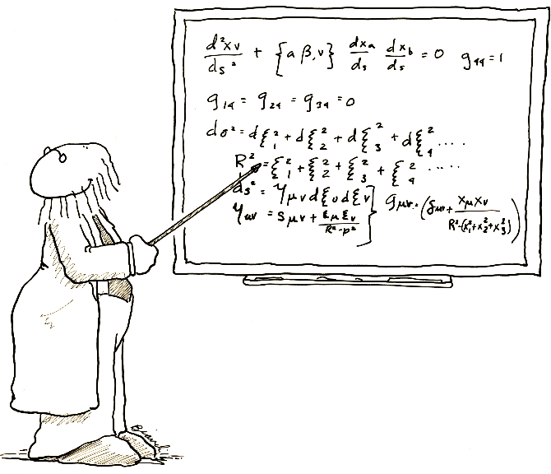
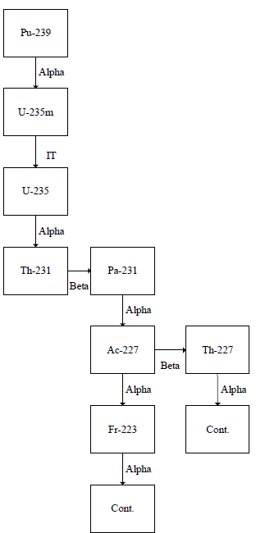
Life at SRS after RADCALC – Birth Announcement for TransCalc
SRS Announces the
birth of their latest
Radioactive
Determination
Spreadsheet
TransCalc
Born: Feb. 17, 2016

Slide 10
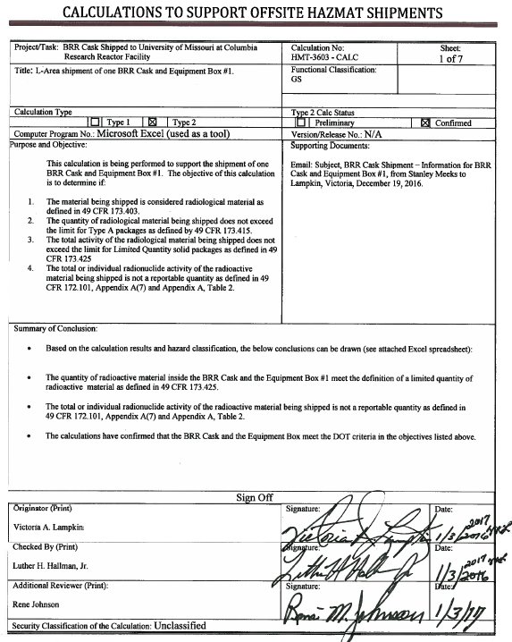
Life at SRS after RADCALC – Rad. Calculation Determination Cover Sheet

Slide 11
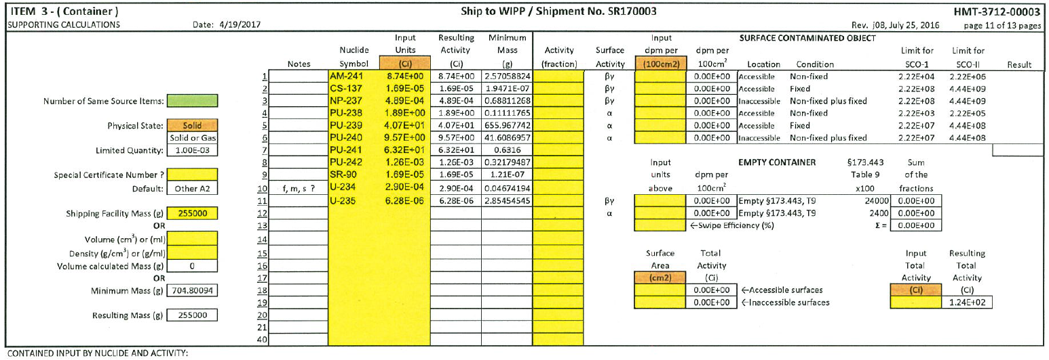
Life at SRS after RADCALC – TransCalc Input Data

Slide 12
Life at SRS after RADCALC – TransCalc Determination

Slide 13
Life at SRS after RADCALC - Summary
Although RADCALC 4.1 is not available to SRNS, we have developed “alternative methods” to assist in radioactive determinations
Without RADCALC 4.1, time to complete a TransCalc, on average, is about 5-6 man-hours
SRNS eagerly awaits the birth announcement for RADCALC 4.2

Slide 14
Life at SRS after RADCALC - Questions

